Slide 1



Encryption Strategies For SQL Server
Eric Peterson
Peterson_eric_a@hotmail.com

Slide 2
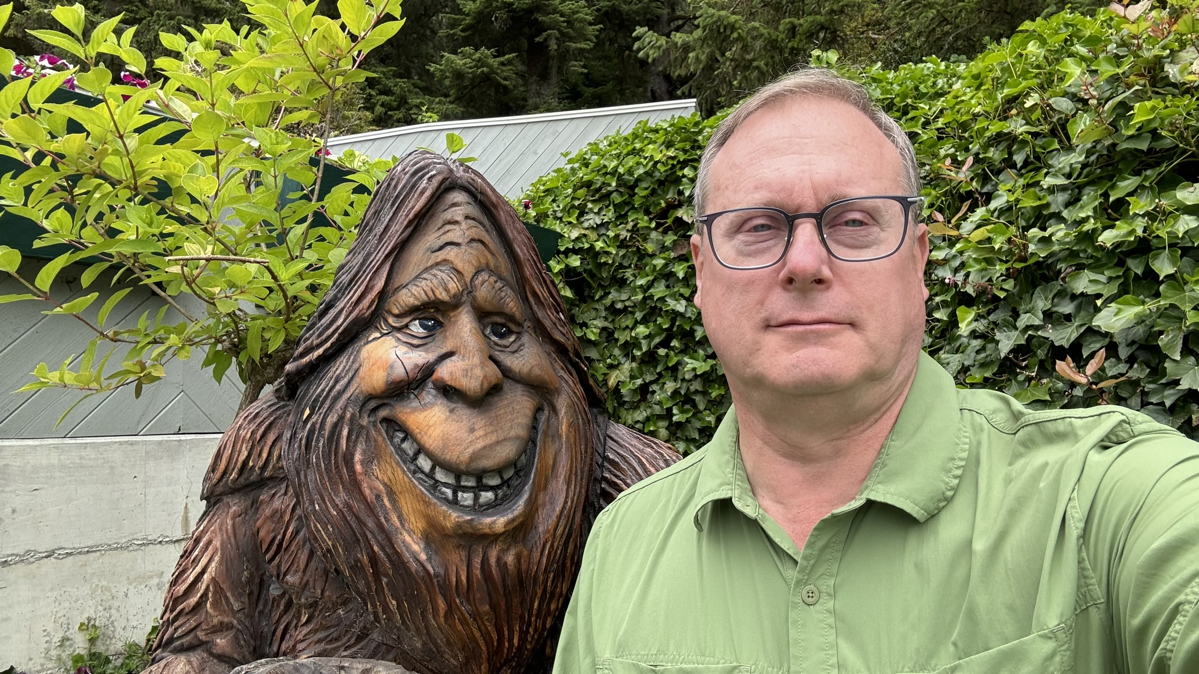


Background
Over 40 years of Database experience
DB2, Sybase, Oracle, MS SQL Server
Former Sybase Lead Architect
Over 30 years of SQL Server experience
SQL Server 4.2, 1993 with Sybase
Part of the ODBC Development Team
Avid Hiker & National Park Junkie

Slide 3

How do you Hack a SQL Server database?
Easiest
Get access to the backup directory
Copy the backup file
Restore it to another SQL Server
Midrange
Get access to the SQL Server data directory or old disk
Look for mdf files that you can copy & attach
Harder
Hack a SQL login or application
Copy data directly from the database

Slide 4



How to prevent hacking attacks
Encrypt your Backups
Encrypt your data files
IE: Encryption at rest
Encrypt your Data Fields
Save your encryption keys

Slide 5
Encrypted Backups
Set-up for Encrypting a backup
How to take an Encrypted Backup
How to restore an Encrypted Backup
Tools for working with Encrypted backups
Examples

Slide 6


Encrypted Backups Architecture
Setup Master Key
Installed on all Production SQL Servers
Setup Certificate
Installed on all SQL Servers
and backed up
Backup Certificate
Backup Databases with Encryption
Restore is automatic
if you have the certificate

Slide 7
How Encrypted Backups Work
Create A Master Key
SQL Server
USE master
go
IF NOT EXISTS (SELECT * FROM sys.symmetric_keys WHERE symmetric_key_id = 101)
BEGIN
PRINT 'Creating Database Master Key'
CREATE MASTER KEY
ENCRYPTION BY PASSWORD = 'T0t0, I Dont Th!nk WE @re in Kansas anymore!';
END
ELSE
PRINT 'Master Key Already Exists'
Database 1
Database 2

Slide 8
How Encrypted Backups Work
Create A Certificate
SQL Server 1
CREATE CERTIFICATE EncryptionCertificateBackup2
WITH SUBJECT = 'SQL Server Backup Encryption Certificate',
EXPIRY_DATE = '20311114’;
CREATE CERTIFICATE EncryptionCertificateBackup1
ENCRYPTION BY PASSWORD = 'A R@nd0m1y G3nerated Pa$$w0rd’
WITH SUBJECT = 'SQL Server Backup Encryption Certificate',
EXPIRY_DATE = '20311114';
Database 1
Encryption
Certificate
System1
Database 2
If you supply a Password, you have to supply the PW when taking your backup.
Expiry Date: you will need a new certificate after this date. Note: It will still work for restores

Slide 9
How Encrypted Backups Work
Backup Your Certificate
SQL Server 1
Directory or S3 Bucket
Database 1
BACKUP CERTIFICATE EncryptionCertificateBackup2
TO FILE = 'c:\storedcerts\EncCertBackup1.BAK’
WITH PRIVATE KEY
( FILE = ' 'c:\storedcerts\ EncCertBackup1.PKK' ,
ENCRYPTION BY PASSWORD
= '>Save This P@$$word in y0ur Password VaulT’ );
GO
Database 2

Slide 10
How Encrypted Backups Work
Backup Your Database
SQL Server 1
Encrypted Backup Database 1
Encrypted Backup Database 2
Database 1
Backup Database [Database1]
to disk = 'C:\Backups\Database1-2023-01-09_105500.BAK'
with compression ,
ENCRYPTION
(ALGORITHM = aes_256,
SERVER CERTIFICATE = EncryptionCertificateBackup2)
Database 2

Slide 11
How Encrypted Backups Work
Restore Your Databases
SQL Server 1
Encrypted Database 1 Backup
Encrypted Database 2 Backup
Database 1
Restore Database [Database1]
From disk = 'c:\Backups\Database1-2023-01-09_105500.BAK’
WITH RECOVERY
Database 2
Because the certificate exists, the restore works!
If you have a Passworded certificate, you have to supply the PW when restoring.

Slide 12
How Encrypted Backups Work
$#1T
Happens
SQL Server 1
Encrypted Database 1 Backup
Encrypted Database 2 Backup
Database 1
Database 2

Slide 13
How Encrypted Backups Work
Rebuild Your SQL Server
SQL Server 1
Encrypted Database 1 Backup
Encrypted Database 2 Backup

Slide 14
How Encrypted Backups Work
Restore Database?
SQL Server 1
Encrypted Database 1 Backup
Cannot Restore an Encrypted Backup
Encrypted Database 2 Backup

Slide 15
How Encrypted Backups Work
Recreate Master Key
SQL Server 1
Encrypted Database 1 Backup
Encrypted Database 2 Backup
CREATE MASTER KEY
ENCRYPTION BY PASSWORD
= 'T0t0, I Dont Th!nk WE @re in Kansas anymore!';

Slide 16
How Encrypted Backups Work
Restore Certificate
SQL Server 1
Encrypted Database 1 Backup
Encrypted Database 2 Backup
CREATE CERTIFICATE EncryptionCertificateSystem1
FROM FILE = 'c:\storedcerts\System1EncCert.bak’
WITH PRIVATE KEY ( FILE = 'c:\storedcerts\System1EncCert.PKK’
DECRYPTION BY PASSWORD
= '>SaveD P@$$word y0ur Password VaulT';

Slide 17
How Encrypted Backups Work
Restore Your Databases
SQL Server 1
Encrypted Database 1 Backup
Encrypted Database 2 Backup
Database 1
Restore Database [Database1]
From disk = 'c:\Backups\Database1-2023-01-09_105500.BAK’
WITH RECOVERY
Database 2

Slide 18
How Encrypted Backups Work
Back in Business
SQL Server 1
Encrypted Database 1 Backup
Encrypted Database 2 Backup
Database 1
Database 2

Slide 19
Encrypted Backup Using SQL
Backup Database [IOStats]
To disk = ’D:\SQL_BACKUPS\SQL01\IOStats_2024_11_02_100726.bak’
With compression,
Encryption ( ALGORITHM = aes_256,
Server CERTIFICATE = DBEncryptedBackupCert2 )

Slide 20
Encrypted Backup Using Olya’s Scripts
EXECUTE dbo.DatabaseBackup
@Databases = 'IOStats'
,@DirectoryStructure = NULL
,@FileName= '{DatabaseName}_{BackupType}_{Year}_{Month}_{Day}_{Hour}
{Minute}{Second}_{FileNumber}_{Partial}_{CopyOnly}.{FileExtension}'
,@BackupType = 'FULL'
,@ChangeBackupType = 'Y'
,@Compress='Y'
,@CheckSum='Y'
,@BufferCount=64
,@MaxTransferSize=4194304
,@LogToTable='Y'
,@Encrypt = 'Y'
,@EncryptionAlgorithm = 'AES_256'
,@ServerCertificate = 'DBEncryptedBackupCert'
,@Execute='Y'

Slide 21
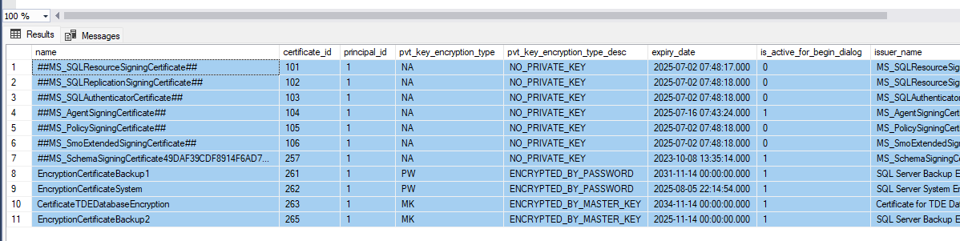
How to find a Certificate
Select * From sys.certificates

Slide 22
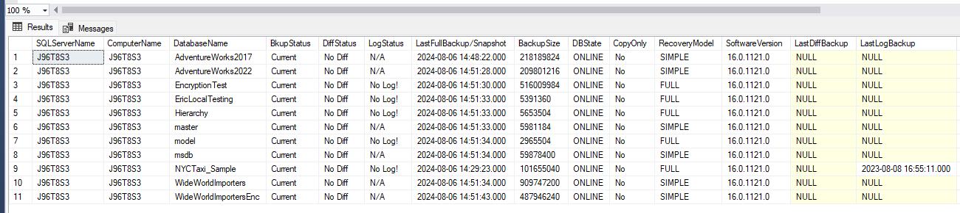
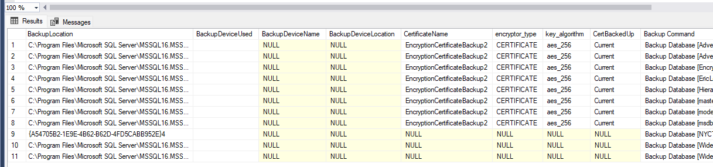
How to Identify an Encrypted Backup
sp_backupinfo
If Certificate name is NULL – It is not encrypted

Slide 23
Encrypting Your Data Files
OS File System
Encryption At Rest IE:
Files with sensitive data must be encrypted
SQL Server has the files locked while in use,
But what if:
Hard drive Replacement
SQL Server is down / shutdown / Retired
Bitlocker or other drive encryption software
Allows the copy of files
D:/MSSQL/ Database1.MDF Database1.LDF

Slide 24
Encrypting Your Data Files
OS File System
SQL Server 1
Each Database
= Disk files
D:/MSSQL/ Database1.MDF Database1.LDF
Database 1
Database 2
D:/MSSQL/ Database2.MDF Database2.LDF

Slide 25
Encrypting Your Data Files
OS File System
When the SQL Server is down / decommissioned
The files are out there unlocked,
Ready to copy
Attach Database ….
D:/MSSQL/ Database1.MDF Database1.LDF
Your Data
D:/MSSQL/ Database2.MDF Database2.LDF

Slide 26
You NEED to be Encrypting Your Data Files
OS File System
TDE
Transparent Data Encryption
Seamless encryption of data/log files
Built into SQL Server
D:/MSSQL/ Database1.MDF Database1.LDF

Slide 27
Transparent Data Encryption
OS File System
SQL Server 1
Add
Master Key
Or
Skip if done
D:/MSSQL/ Database1.MDF Database1.LDF
Database 1
CREATE MASTER KEY
ENCRYPTION BY PASSWORD
='BananaBreadRobVolk';
Database 2

Slide 28
Encrypting Your Data Files
OS File System
SQL Server 1
Add Certificate
Different than the backup Certificate
D:/MSSQL/ Database1.MDF Database1.LDF
Database 1
Database 2
CREATE CERTIFICATE CertificateTDEDatabaseEncryption
WITH SUBJECT='Cert for TDE DB Encryption' ,
EXPIRY_DATE = '20341114';
GO

Slide 29
Encrypting Your Data Files
OS File System
SQL Server 1
Encrypt the DB
USE [WorldImporters]
GO
CREATE DATABASE
ENCRYPTION KEY
WITH ALGORITHM
= AES_256
ENCRYPTION BY
SERVER CERTIFICATE
CertificateTDEDatabaseEncryption;
GO
ALTER DATABASE
WorldImporters
SET ENCRYPTION ON;
GO
D:/MSSQL/ Database1.MDF Database1.LDF
Database 1
Database 2

Slide 30
Encrypting Your Data Files
OS File System
SQL Server 1
Issues w/TDE
Large DBs
Time to encrypt
Backup of DBs will already be encrypted
D:/MSSQL/ Database1.MDF Database1.LDF
Database 1
Database 2

Slide 31
Encrypting your Table Data Columns
PCI
Credit Card Data
Bank Account Data
PII
Social Security Number ( National ID )
Passport Number
Driver License Number
Phone Number
Name
Birth Date
Address
123-45-6789
XXX-XXX-XXX

Slide 32
Encryption Methods
Appliance or Software
External to SQL Server
Certificate Encryption
Uses an internal certificate, password
Always Encrypted
Application Centric Encryption
Encrypting Stored Procedures
Encrypts procedure text and prevents changes
123-45-6789
XXX-XXX-XXX
123-45-6789
XXX-XXX-XXX
123-45-6789
XXX-XXX-XXX

Slide 33
Appliance
External to SQL Server
Can be
a physical piece of hardware that is installed in your rack
software solution
Often passes back a token that can be stored in the DB
Cannot directly query un-encrypted data
123-45-6789
98765

Slide 34
Using SQL Server to Encrypt Your Data
Database Table
# FirstName LastName SSN Amt Email BirthDate
1 Eric Peterson 123-34-5678 1234 eric.peters@ABC123.com 1961-11-14 00:00:00.000
2 Rohan Sherman 123-34-6969 100 rohan.sherman@ABC123.com 1970-11-30 00:00:00.000
3 Randy Sandsky 123-34-9876 99 Randy.Sandy@ABC123.com 1989-12-14 00:00:00.000
4 Tommy Twotone 123-34-1234 5555 Tommy.Turner@ABC123.com 1999-01-19 00:00:00.000
5 Shawn Maxwell 123-34-2345 4321 Shawn.Maxumus@ABC123.com 2020-02-11 00:00:00.000
6 Homer KillaDba 123-34-5432 234 Homer.Simpson@ABC123.com 1971-03-10 00:00:00.000
7 Prashant Bang 123-34-0987 34 Thebig.Bang@ABC123.com 2000-04-15 00:00:00.000

Slide 35
Prepare your table for Encryption
Encryption requires a Varchar(Max) column
Existing column is varchar(11)
ALTER TABLE dbo.TestPatient
ADD SSNEncrypted VARBINARY(MAX)

Slide 36
Setup Certificate and Symmetric Keys in DB
CREATE CERTIFICATE SSNCertWithPW
ENCRYPTION BY PASSWORD = 'CertPa$$word12345!!’
WITH SUBJECT = 'SSN Encryption Certificate w/PW'
GO
CREATE SYMMETRIC KEY SSNSymetric_keyWithPW
WITH ALGORITHM = AES_256
ENCRYPTION BY CERTIFICATE SSNCertWithPW;
GO

Slide 37
Encrypting your Data via Symmetric Key
Open your Symmetric Key
Provide the PW
Perform data action using the EncryptByKey function
IE: EncryptByKey(Key_GUID('SSN_Key_01'), SSN)
Close your Symmetric Key
0x007086B5D7764C4C9D34C0B1B6BDA93602000000DE47FB02FB5C8D44BE74E627060CD7E3FE01FB29EC51EA57145416D8EECD303E98200B0CE0FC7E7F64F4D0F5B35EBF12
123-456-7890

Slide 38
Symetric Key Encryption Example
OPEN SYMMETRIC KEY SSNCertWithPW
DECRYPTION BY CERTIFICATE SSNCertWithPW
WITH PASSWORD = 'CertPa$$word12345!!'
UPDATE dbo.TestPatient
SET SSNEncrypted = EncryptByKey(Key_GUID('SSNSymetric_key'), SSN)
FROM dbo.TestPatient
GO
CLOSE SYMMETRIC KEY [SSNSymetric_key]
GO

Slide 39
Decrypting your Data via Symmetric Key
Open your Symmetric Key
Provide the PW
Perform data action using the DECRYPTBYKEY function
IE: DecryptByKey(EncryptedSSN)
Close your Symmetric Key
0x007086B5D7764C4C9D34C0B1B6BDA93602000000DE47FB02FB5C8D44BE74E627060CD7E3FE01FB29EC51EA57145416D8EECD303E98200B0CE0FC7E7F64F4D0F5B35EBF12
123-456-7890

Slide 40
Decrypt via Symmetric Key Example
OPEN SYMMETRIC KEY SSNSymetric_keyWithPW
DECRYPTION BY CERTIFICATE SSNCertWithPW
WITH PASSWORD = 'CertPa$$word12345!!’
SELECT patientId, LastName, FirstName, SSNEncrypted,
CONVERT(NVARCHAR, DECRYPTBYKEY(SSNEncrypted)) AS 'SSN'
FROM dbo.TestPatient
CLOSE SYMMETRIC KEY SSNSymetric_keyWithPW
GO

Slide 41
Encrypted Column Usage Hints
Store a token or use the primary key
Easier to pass around and query
Store a masked Value’ for use in reports
IE: XXX-XX-8936
Pulling a key from AWS or Azure Key Vault
Can be slow

Slide 42
Always Encrypted Data
Lets the developers encrypt and decrypt in the application, automatically in ADO.net
DBAs are considered untrustworthy
The keys are never given to SQL Server.
All encryption/decryption is done in the application.
The “trust boundary” stops with ADO.NET –
SQL Server is considered untrusted
So is network, etc.
Offsite data
Azure or Amazon hosting

Slide 43
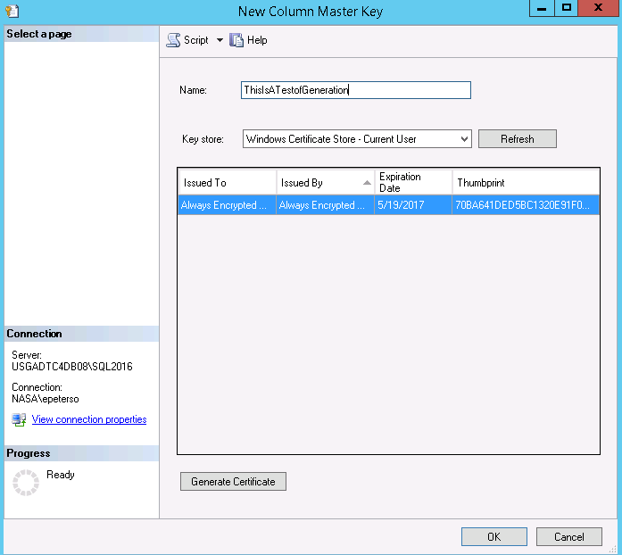
Always Encrypted Setup
Database Security Admin generates:
Column master key(CMK)
Column encryption key(CEK)
USE Management Studio Wizard
Key Store
Current User
Local Machine
Azure Key Vault
CEK in the database
Comes back with a restore
Always On
Will automatically propagate

Slide 44
Types of Data Encryption
ABCDEFG = 0x4365727450617373776F72643132333435212B
Randomized:
if you encrypt the same value twice,
You’ll get two different encrypted values.
Bad If you join between tables or do GROUP BY, etc.
Deterministic encryption:
Encrypt the same value multiple times,
you’ll always get the same encrypted values.
Less secure, but lets you do equality operations
Tokenization
Replaces or adds an a “Token” integer, the original value is stored encrypted or can be retrieved
ABCDEFG = 0x173481204637373776G7261234599914352B13
ABCDEFG = 0x4365727450617373776F726431323334352121
ABCDEFG = 0x4365727450617373776F726431323334352121
ABCDEFG = 1

Slide 45
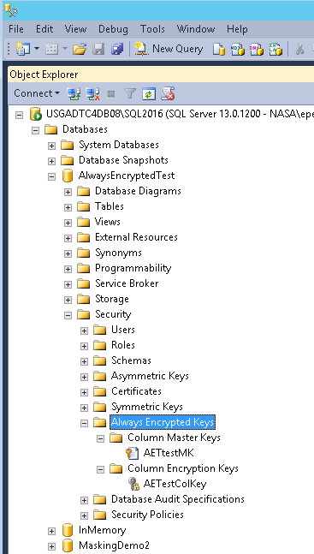
Always Encrypted
The encrypted keys will be exposed in new system tables,
In SSMS under: databases
Security tree
Always Encrypted Keys
Column Master Keys
Column Encryption Keys
Needs to be published
To application

Slide 46
How to Always Encrypt a Table
CREATE TABLE [dbo].[Patients](
PatientId [int] IDENTITY(1,1),
SSN [nvarchar](11) COLLATE Latin1_General_BIN2
ENCRYPTED WITH (ENCRYPTION_TYPE = DETERMINISTIC,
ALGORITHM = 'AEAD_AES_256_CBC_HMAC_SHA_256', COLUMN_ENCRYPTION_KEY = AETestColKey) NOT NULL,
FirstName [nvarchar](50) NULL,
LastName [nvarchar](50) NULL,
MiddleName [nvarchar](50) NULL,
StreetAddress [nvarchar](50) NULL,
City] [nvarchar(50) NULL,
ZipCode [int] NULL,
State [nvarchar](50) NULL,
BirthDate [datetime2] ENCRYPTED WITH (ENCRYPTION_TYPE = RANDOMIZED,
ALGORITHM = 'AEAD_AES_256_CBC_HMAC_SHA_256', COLUMN_ENCRYPTION_KEY = AETestColKey) NOT NULL
PRIMARY KEY CLUSTERED
([PatientId] ASC)
ON [PRIMARY] )

Slide 47
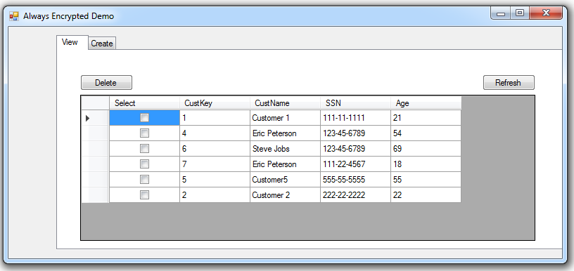
Use by the aplication
Certificate is generated
Encryption is at the Application

Slide 48
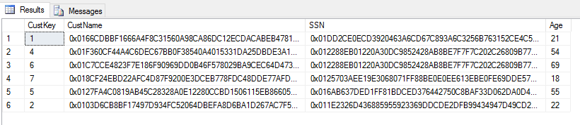
Data is Encrypted – for queries
Name – Randomized
SSN - Deterministic
select *
from [dbo].[Customers]

Slide 49
Encrypting Sensitive Stored Procedures
We can encrypt stored procedures to help protect them from being viewed or edited.
SQL Server converts the original text of the CREATE PROCEDURE statement to an obfuscated format.
Encrypting a stored procedure prevents viewing or changing the code *
There are ways to get around this….
Users with permission can execute the stored procedure

Slide 50

Dynamic Data Masking
Dynamic data masking limits sensitive data exposure by masking it to non-privileged users.
A policy-based security feature
Hides (Masks) sensitive data in the result set
User Designated database fields
Leaves the database is not changed.
Masking rules are applied in the query results
Not as secure
Best use is with stored procs or reports
Ad-hock queries can unmask data
Where clause can query for match
Note: Don’t programmatically update all cols
Will overwrite with mask

Slide 51
Dynamic Data masking
Default
Numeric: 000000
Datetime: 2000-01-01 00:00:00.000
String: XXXXXX
Email
Predefined Format: RXXX@XXXX.com
Partial
User Defined: XXXX-XXXX-XXXX-6969

Slide 52
Adding Masking to a Table/Column
ALTER TABLE MyCustomers
ALTER COLUMN [PurchaseTotAmt]
ADD MASKED --< the magic
WITH (FUNCTION = 'default()')-- default on int
ALTER TABLE MyCustomers
ALTER COLUMN [CreateDate]
ADD MASKED
WITH (FUNCTION = 'default()')-- default on date
ALTER TABLE MyCustomers
ALTER COLUMN [FirstName]
ADD MASKED
WITH (FUNCTION = 'default()')-- default on varchar

Slide 53
Adding NonDefault Masks to Table
--************* Masked Partial Setup *******************
ALTER TABLE MyCustomers
ALTER COLUMN CreditCard ADD MASKED
WITH (FUNCTION = 'partial(0, "XXXX-XXXX-XXXX-",4)')
-- (Start, mask format, Post Mask)
--************* Masked email Setup *******************
ALTER TABLE MyCustomers
ALTER COLUMN OfficeEmail ADD MASKED
WITH (FUNCTION = 'email()')

Slide 54
Clear Results
SELECT *
FROM MyCustomers; -- clear data
GO
# FirstName LastName CreditCard Amt OfficeEmail CreateDate
1 Eric Peters 1234-5678-1234-5678 1234 eric.peters@ABC123.com 2023-11-14 00:00:00.000
2 Rohan Sherman 1234-5678-1234-6969 100 rohan.sherman@ABC123.com 2023-11-30 00:00:00.000
3 Randy Sandy 1234-5678-1234-9876 99 Randy.Sandy@ABC123.com 2023-12-14 00:00:00.000
4 Tommy Twotone 1234-5678-1234-1234 5555 Tommy.Turner@ABC123.com 2024-01-19 00:00:00.000
5 Shawn Maxwell 1234-5678-1234-2345 4321 Shawn.Maxumus@ABC123.com 2024-02-11 00:00:00.000
6 Homer Simpson 1234-5678-1234-5432 234 Homer.Simpson@ABC123.com 2024-03-10 00:00:00.000
7 Thebig Bang 1234-5678-1234-0987 34 Thebig.Bang@ABC123.com 2024-04-15 00:00:00.000

Slide 55
Masked Results
EXECUTE AS USER = 'AGENT';
SELECT * FROM MyCustomers;--masked data
REVERT;
# FirstName LastName CreditCard Amt OfficeEmail CreateDate
1 XXXX Peters XXXX-XXXX-XXXX-5678 1234 EXXXXXXXXX@ABC123.com 2023-11-14 00:00:00.000
2 XXXX Sherman XXXX-XXXX-XXXX-6969 100 RXXXXXXXXX@ABC123.com 2023-11-30 00:00:00.000
3 XXXX Sandy XXXX-XXXX-XXXX-9876 99 RXXXXXXXXX@ABC123.com 2023-12-14 00:00:00.000
4 XXXX Twotone XXXX-XXXX-XXXX-1234 5555 TXXXXXXXXX@ABC123.com 2024-01-19 00:00:00.000
5 XXXX Maxwell XXXX-XXXX-XXXX-2345 4321 SXXXXXXXXX@ABC123.com 2024-02-11 00:00:00.000
6 XXXX Simpson XXXX-XXXX-XXXX-5432 234 HXXXXXXXXX@ABC123.com 2024-03-10 00:00:00.000
7 XXXX Bang XXXX-XXXX-XXXX-0987 34 TXXXXXXXXX@ABC123.com 2024-04-15 00:00:00.000

Slide 56

Issues with masking
Masking is not stored on disk
Data will match a query, Brute force attack
Can be bypassed
DBO user
Anyone with access can query against column values
EXECUTE AS USER = 'ResAGENT';
Select LastName , CreditCard
where CreditCard = '1234-5678-1234-9876' --> Match masked number
from MyCustomers
REVERT;
LastName Credit Card
Sandy XXX-XXXX-XXXX-9876

Slide 57
Contact Info and Downloads
Github
https://github.com/SQLeap61
Repositories
EncryptionPresentationAndExampleScripts
SQL-Scripts
Email:
Peterson_eric_a@hotmail.com

Slide 58

The End

